Slide 1

NEIGHBORHOOD STRUCTURE

Slide 2

OUTLINE
Introduction
Objective
Some key words
How it works ?
Example

Slide 3
INTRODUCTION
Neighbor is a person who lives next to us
Neighborhood means
- a community in a town or city
- created by social interaction
between a group of people

Slide 4
INTRODUCTION
module
Neighbor – modules
City/Town – area
Neighborhood – interconnection between the modules
module
module
module
module

Slide 5
Objective
Changing a normalized polish expression through perturbation to obtain its corresponding slicing floorplans with zero dead space

Slide 6
Some key words
OPERAND
OPERATOR
1 2 H 3 4 H 5 H V
Normalized Polish Expression

Slide 7
Some key words
ADJACENT OPERAND
ADJACENT OPERATOR
1 2 H 3 4 H 5 H V
Normalized Polish Expression
Adjacent Operand : No operands between two operands
Adjacent Operator : No operands between two operators

Slide 8
Some key words
1 2 H 3 4 H 5 H V
CHAIN
No Consecutive Operators of Same Type

Slide 9
HOW IT WORKS ?
3 types of moves –
M1 : Operand Swap
Swap two adjacent operands
M2 : Chain Invert
Invert a chain by changing V to H and H to V
M3 : Operator/Operand Swap
Swap two adjacent operands and operators

Slide 10
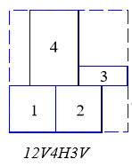
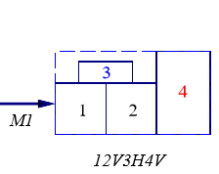
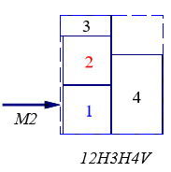
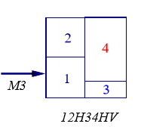
EXAMPLE
12V4H3V
12V3H4V
12H3H4V
12H34HV

Slide 11
CHECKING LEGALITY
Balloting Property :
M1 and M2 moves are OK
M3 could make the number of operands not greater than that of operators, which violates the balloting property

Slide 12
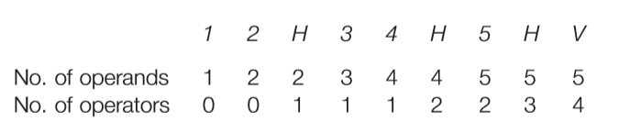
CHECKING LEGALITY
Balloting Property :

Slide 13
CHECKING LEGALITY
No Consecutive Operators :
M1 and M2 moves are OK
M3 could generate two identical consecutive operators that violates the legal property of normalized polish expression

Slide 14
THANK YOU

